Slide 1


LEADERSHIP & ITS STYLE

Slide 2

Introduction
Leadership is the ability to develop a vision that motivates others to move with a passion toward a common goal. So leadership is a process by which a person influences others to accomplish an objective and directs the organization in a way that makes it more cohesive and coherent.

Slide 3

Definition
leadership is the “process of social influence in which one person can enlist the aid and support of others in the accomplishment of a common task”.
M Chemers.
"Leadership is ultimately about creating a way for people to contribute to making something extraordinary happen."
Alan Keith.

Slide 4

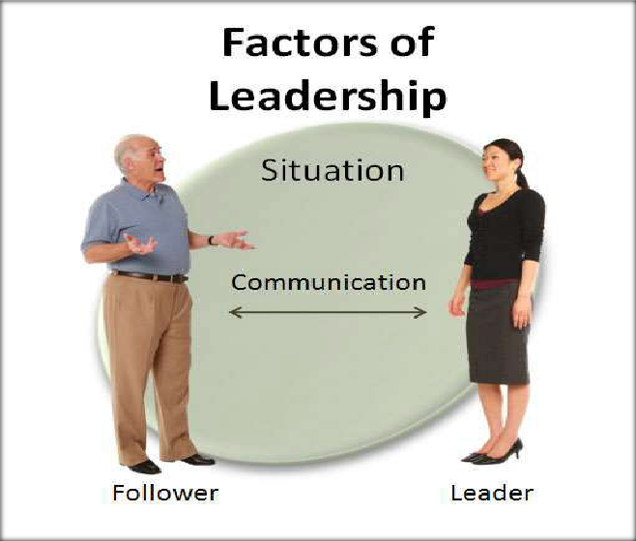
Four factors of leadership

Slide 5
Leader - You must have an honest understanding of who you are, what you know and what you can do. To be successful you have to convince your followers not your superiors, that you are worthy of being followed.
Follower -You must know your people. The fundamental starting point is having a good understanding of human nature, such as needs, emotions and motivation.

Slide 6
Communication-The nonverbal communication is leading. E.g.- when you set example that communicates to your people that you would not ask them to perform anything that you would not be willing to do. Bad communication harm the relation between leader and employee.
Situation-We must use our judgment to decide the best course of action and the leadership style needed for each situation. What we do in one situation will not always work in another.

Slide 7

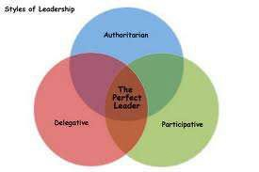
Styles of leadership
The three major styles of leadership are (U.S. Army Handbook, 1973) :
➢Authoritarian or autocratic
➢Participative or democratic
➢Delegative or Free Reign

Slide 8



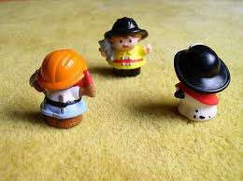
Autocratic – The authoritarian leader makes decisions alone as power is centralized in one person. Decisions are enforced using rewards and the fear of punishment. it is an abusive, unprofessional style called “bossing people around.
”

Slide 9
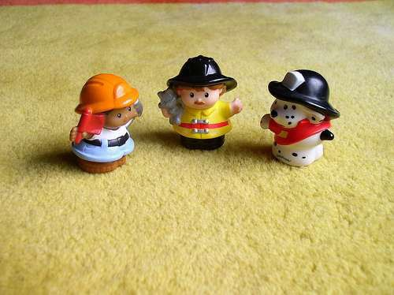
Democratic- The participative leader include one or more employees in the decision making process. Communication flow freely; suggestions are made in both directions. The participation encourages member commitment to the final decisi
on.

Slide 10
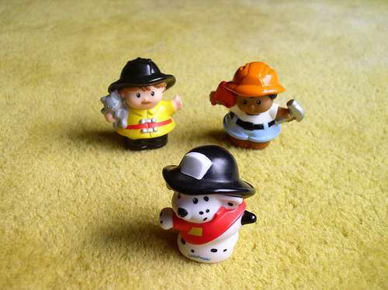
Laissez-faire- The free-rein leader gives power to subordinates to make the decisions. However, the leader is still responsible for the decisions that are made. This is used when employees are able to analyze the situation. Deligative style is generally not useful.

Slide 11









Theories of leadership
TRAIT THEORY
BEHAVIRAL THEORY
CONTINGENCY
THEORY
SITUATIONAL THEORY

Slide 12
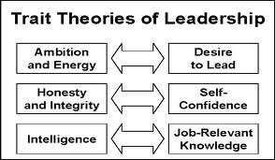
Trait theory-
The Trait Approach arose from the “Great Man” theory as a way of identifying the key characteristics of successful leaders. It was believed that through this theory critical leadership traits could be isolated and that people with such traits could then be recruited, selected, and installed into leadership positions. This theory was common in the military and is still used as a set of criteria to select candidates for commissions.

Slide 13
Advantages of Trait Theory -
It is naturally pleasing theory.
It serves as a yardstick against which the leadership traits of an individual can be assessed.
It gives a detailed knowledge and understanding of the leader element in the leadership process.

Slide 14
Limitations of The Trait Theory –
There is bound to be some subjective judgment
in determining who is regarded as a „good‟ or
„successful‟ leader.
There is also a disagreement over which traits
are the most important for an effective leader

Slide 15


Behavioral Theory-
These theories of leadership are based upon the belief that great leaders are made, not born.
Rooted in behaviorism, this leadership theory focuses on the actions of leaders not on mental qualities or internal states.
According to this theory, people can learn to become leaders through teaching and observation.
The behavior approach says that anyone who adopts the appropriate behavior can be a good leader.

Slide 16



Studies of Behvioral theory
Ohio state leadership university studies.
Managerial Grid
University of Michigan studies

Slide 17

Contingency theory-
In Contingency theory of leadership, the success of the leader is a function of various contingencies in the form of subordinate, task, and/or group variables. The Leaders who are very effective at one place and time may become unsuccessful either when transplanted to another situation or when the factors around them change.
This helps to explain how some leaders who seem for a while to have the 'Midas touch' suddenly appear to go off the boil and make very unsuccessful decisions.

Slide 18
Different Sets/theories of contingency
theory :
➢FIEDLER‟S CONTIINGENCY MODEL
➢HARSEY & BLANCHARD‟S SITUATIONAL THEORY
➢PATH GOAL THEORY
➢VROOM-JAGO CONTINGENCY MODEL

Slide 19

FIEDLER’S CONTINGENCY MODEL
Fiedler's model assumes that group performance depends on:
Leadership style, described in terms of task motivation and relationship motivation.
➢Situational favourableness, determined by three factors:
Leader-member relations - Degree to which a leader is accepted and supported by the group members.
Task structure - Extent to which the task is structured and defined, with clear goals and procedures.
c) Position power - The ability of a leader to control subordinates through reward and punishment.

Slide 20
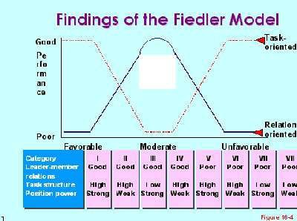

Slide 21
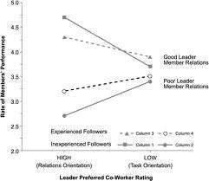

Slide 22


Blanchard's situational theory-
The Hersey-Blanchard Situational Leadership Theory was created by Dr Paul Hersey and Ken Blanchard. The theory states that instead of using just one style, successful leaders should change their leadership styles based on the maturity of the people they're leading and the details of the task. Using this theory, leaders should be able to place more or less emphasis on the task.

Slide 23
According to Hersey and Blanchard, there are four main leadership styles:
Telling (S1) – Leaders tell their people exactly what
to do, and how to do it.
Selling (S2) – Leaders still provide information and direction, but there's more communication with followers. Leaders "sell" their message to get the team on board.
Participating (S3) – Leaders focus more on the relationship and less on direction. The leader works with the team, and shares decision-making responsibilities.
Delegating (S4) – Leaders pass most of the responsibility onto the follower or group. The leaders

Slide 24
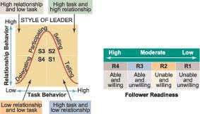

Slide 25



Path-Goal theory-
According to path-goal theory, the leader‟s responsibility is to increase subordinates‟ motivation to attain personal and organizational goal.A person may do these by adopting a certain leadership style, according to the situation:
➢Directive leadership – it tells subordinates exactly what they are supposed to do, which includes planning, making schedules, setting performance goals and behaviour standards.
➢Supportive leadership - it shows concern for
subordinates‟ well being and personal needs.

Slide 26
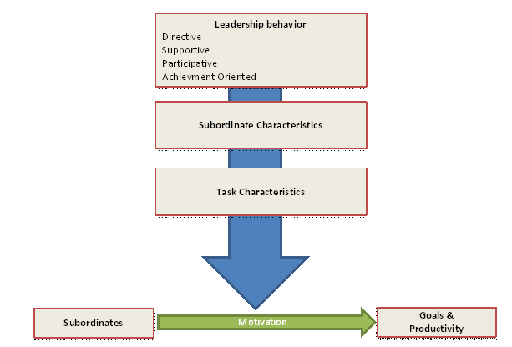
Participative leadership - Decision making is based on group consultation and information is shared with the group.
Achievement-oriented leadership - Challenging goals are set and high performance is encouraged while showing confidence in the groups' ability.

Slide 27

Managerial grid
It describes the relationship between the leader's
concern for task and concern for people, but this theory differs in its perspective. The managerial grid Considers leadership style based on their focus on task and people.
The Managerial Grid is based on two behavioral dimensions:
Concern for People – This is the degree to which a leader considers the needs of team members, their interests, and areas of personal development when deciding how best to accomplish a task.
Concern for Production – This is the degree to which a leader emphasizes concrete objectives, organizational efficiency and high productivity when deciding how best to accomplish a task.

Slide 28
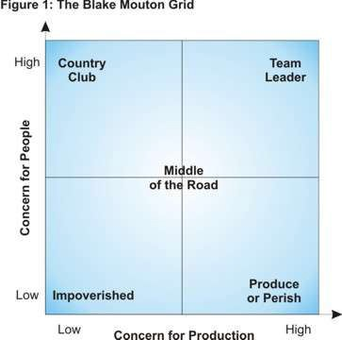
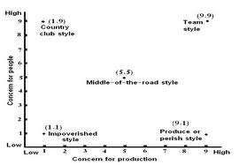
Using the axis to plot leadership „concerns for production‟ versus „concerns for people‟, Blake and Mouton defined the following five leadership styles:

Slide 29
➢Country Club Leadership –(High People/Low Production)
➢Produce or Perish Leadership – High Production/Low People
➢Impoverished Leadership – Low Production/Low People
➢Middle-of-the-Road Leadership – Medium Production/Medium People
➢Team Leadership – High Production/High People

Slide 30

Likert‟s school of leadership
Dr Rensis Likert (1903 - 1981) was a management theorist. According to Likert, the efficiency of an organisation or its departments is influenced by
their system of management. Likert categorised his four management systems as follows:
Exploitive authoritative system
Benevolent authoritative system
Consultative system
Participative (group) system

Slide 31
Exploitative Authoritative: Responsibility lies in the hands of the people at the upper echelons of the hierarchy.
Benevolent Authoritative: The responsibility lies at the managerial levels but not at the lower levels of the organizational hierarchy.
Benevolent Authoritative: The responsibility lies at the managerial levels but not at the lower levels of the organizational hierarchy.
Participative: Responsibility for achieving the organizational goals is widespread throughout the organizational hierarchy.

Slide 32


Advantages | Disadvantages
Simple to construct | Lack of reproducibility
Each item of equal value so that respondents are scored rather than items | Absence of one-dimensionality or homogeneity
Likely to produce a highly reliable scale | Validity may be difficult to demonstrate
Easy to read and complete

Slide 33

References :
From book of leadership by -
Richard L.Draft
Craig M.Watson
From Internet -
D.S.Pugh, 'Organization Theory - Selected Readings',
Robert P.Vecchio, 'Organizational Behaviour‟
A Practical Overview of Evidence Based
Leadership Theory
By Shaun Killian (MLead, MEd), Australian Leadership Development Centre
By Linda D. Henman, Ph.D.

